Slide 1
Checking understanding of basic transformations
Transformations

Slide 2
how to use Oak lessons

Slide 3
I can describe how an object has moved or changed.

Slide 4
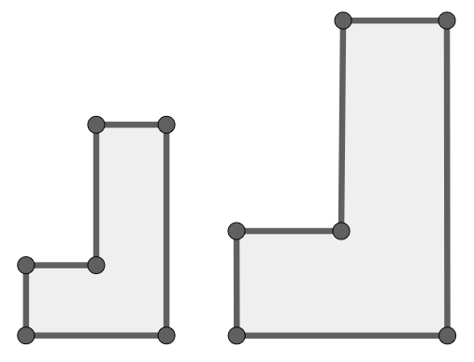
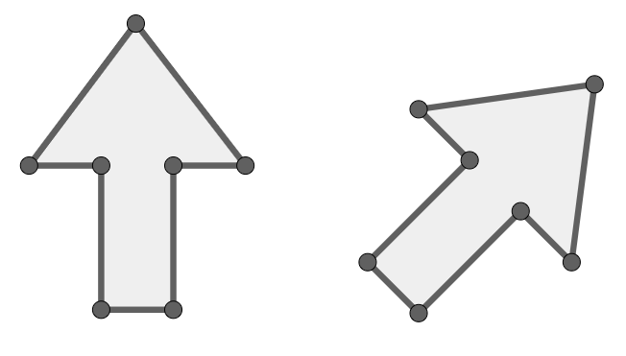
A
F
A
A
A
F
B
B
G
C
C
B
C
F
C
B
D
F
G
D
E
E
D
E
D
E
Example of orientation changing
Example of orientation not changing

Slide 5
The object is the starting figure before a transformation has been applied.
The image is the resulting figure after a transformation has been applied.
A transformation is a process that may change the size, orientation or position of a shape.
Congruent - we will explore this during the lesson.
A property of a shape is invariant if that property has not changed after the shape is transformed.

Slide 6

Checking understanding of basic transformations
Congruency
Describing changes

Slide 7
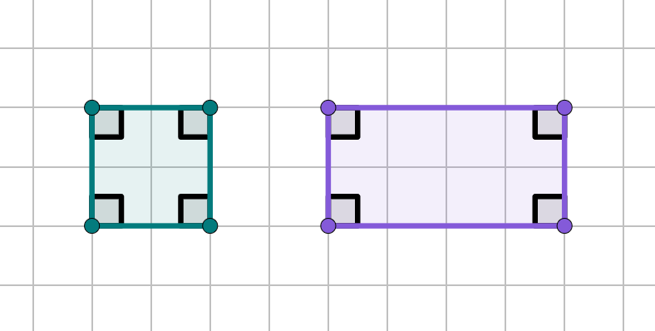
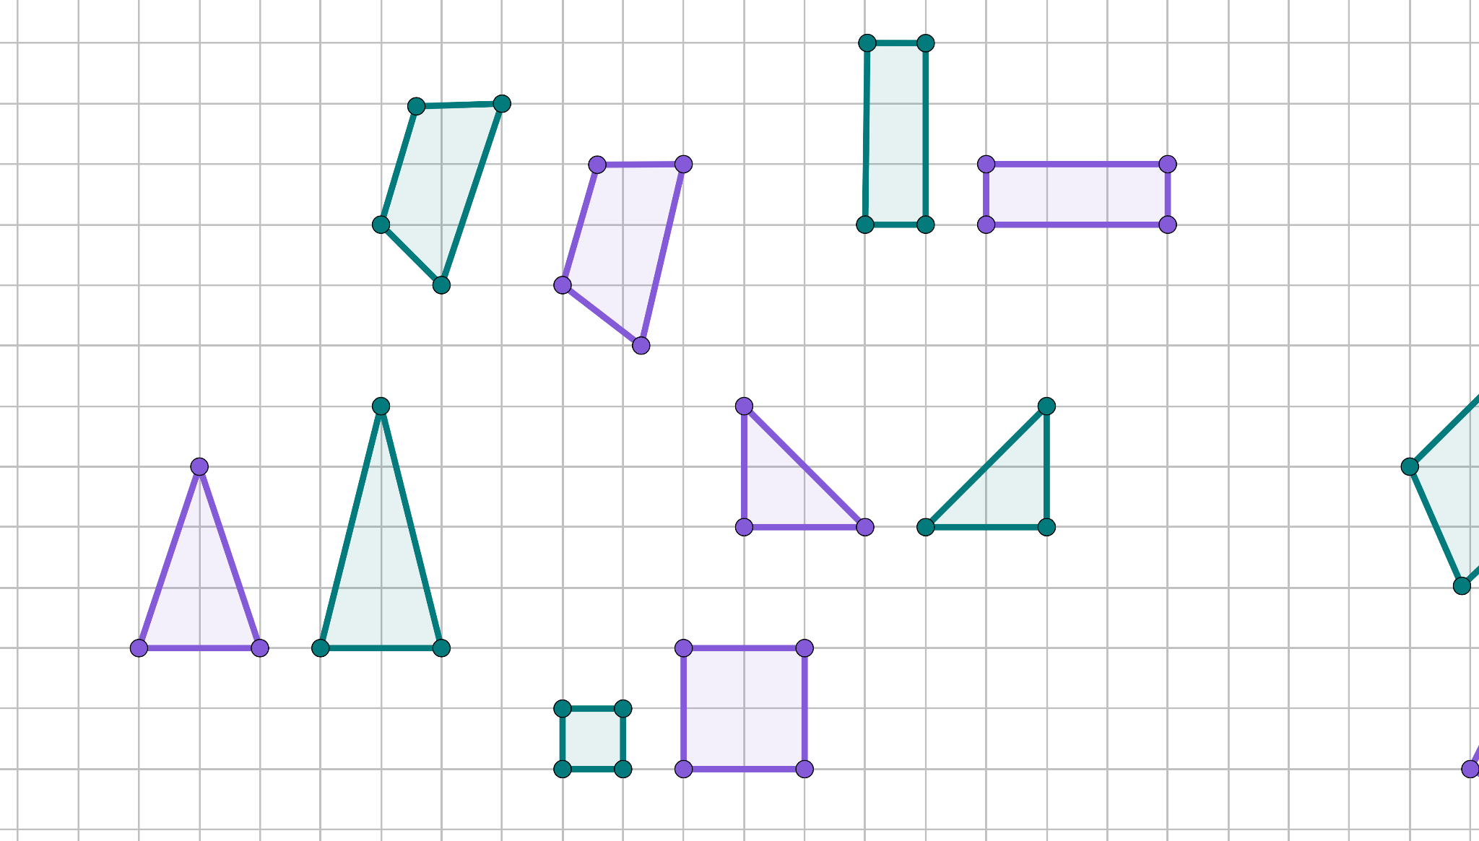

Congruency
Pairs of non-congruent shapes
Pairs of congruent shapes
4 cm
2 cm
4 cm
2 cm
2 cm
4 cm
4 cm
2 cm
What does congruent mean?

Slide 8
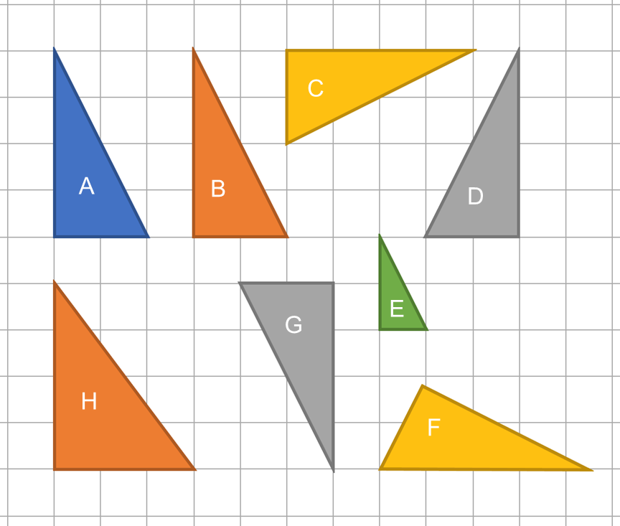
Congruency
Two or more shapes are said to be congruent if one shape can fit exactly on top of another using rotation (twisting), reflection (flipping) or translation (moving).
Which of these triangles are congruent?
A, B, C, D, F and G are identical. If you could cut them out, they would all fit exactly on each other, with some pieces twisted and/or flipped.
NCETM Checkpoint 1 Figure

Slide 9
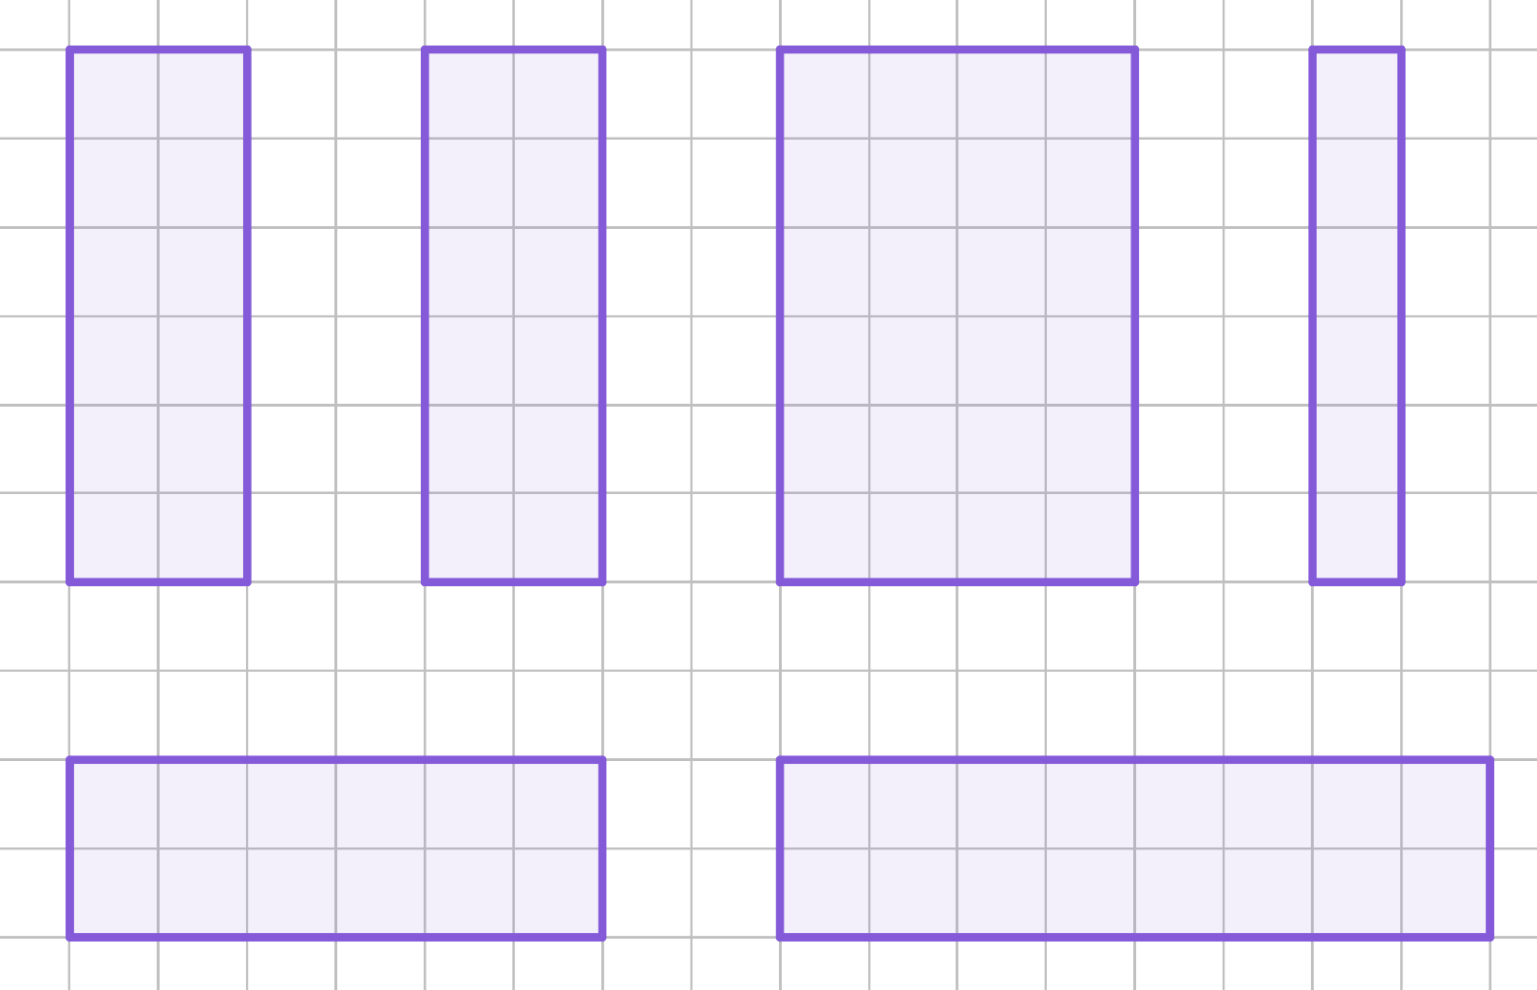
Congruency
Which of the following rectangles are congruent?
A
B
C
D
E
F
A, B and E are congruent to each other. C is too wide, D is too narrow and F is too long.

Slide 10
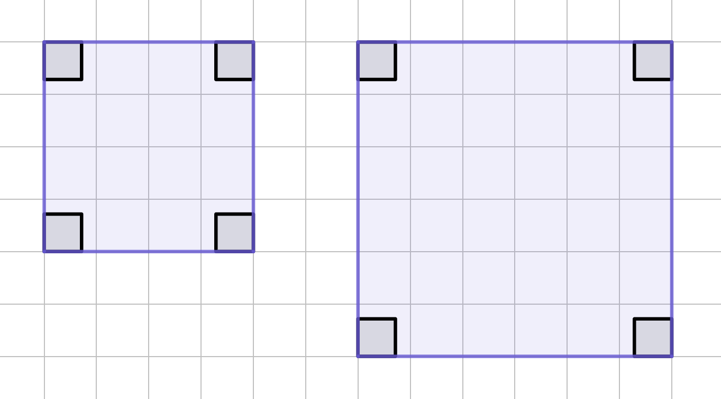
Congruency
Are these two squares congruent?
The shape is the same, the angles are the same, but the size is different, so they are not identical. They are not congruent.

Slide 11
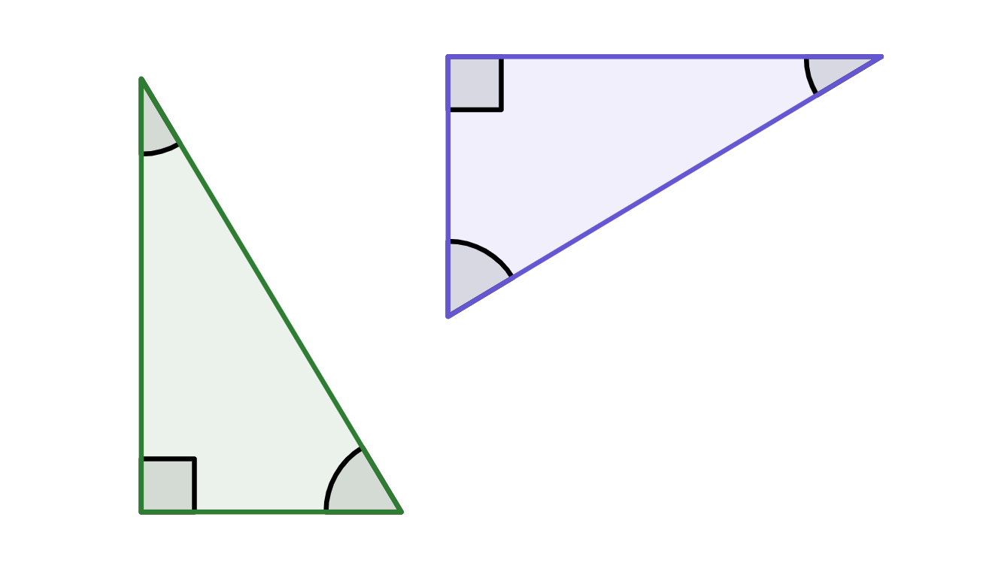
Congruency
Are these two triangles congruent?
5 cm
31°
3 cm
31°
59°
5.8 cm
5.8 cm
5 cm
59°
3 cm
The shape is the same, the angles are the same, the lengths of the edges are the same, so they are congruent.

Slide 12
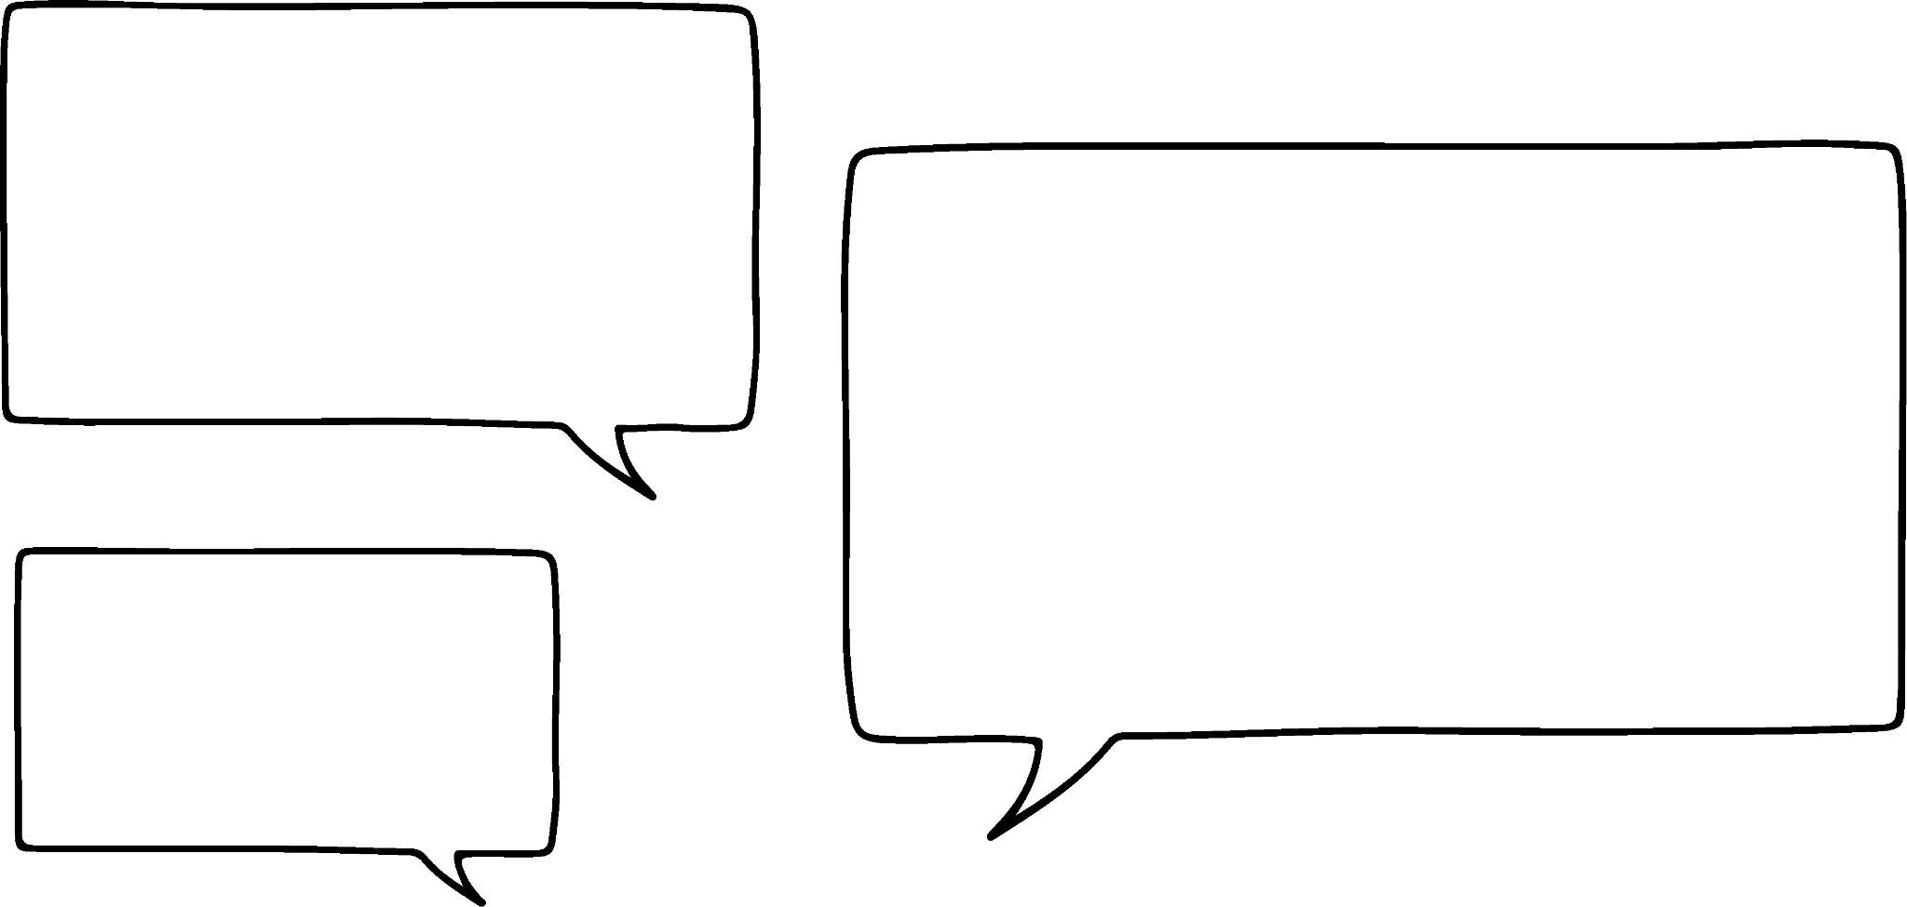

Congruency
Shapes can be congruent to each other even if flipped or rotated.
Do you agree with Laura? Justify your answer.
Laura is right. Flipping and turning a shape doesn’t change the angles or lengths of the object.
“Yes, as the angles and lengths would still be the same.”

Slide 13
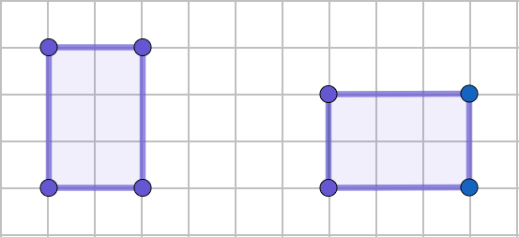
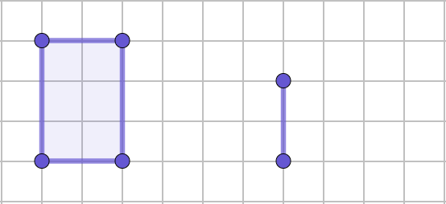
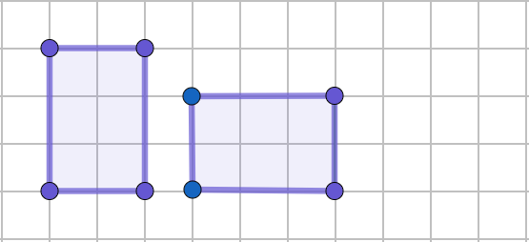
Congruency
Where can we put the two final vertices of the rectangle, to make it congruent to the purple rectangle?

Slide 14
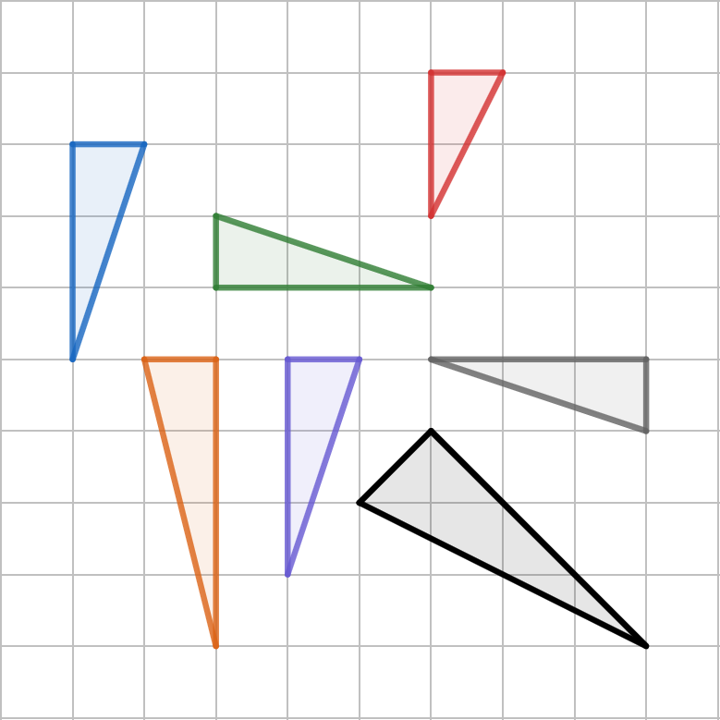
Congruency
1) Which of these triangles are congruent?
C
A
B
D
E
F
G

Slide 15
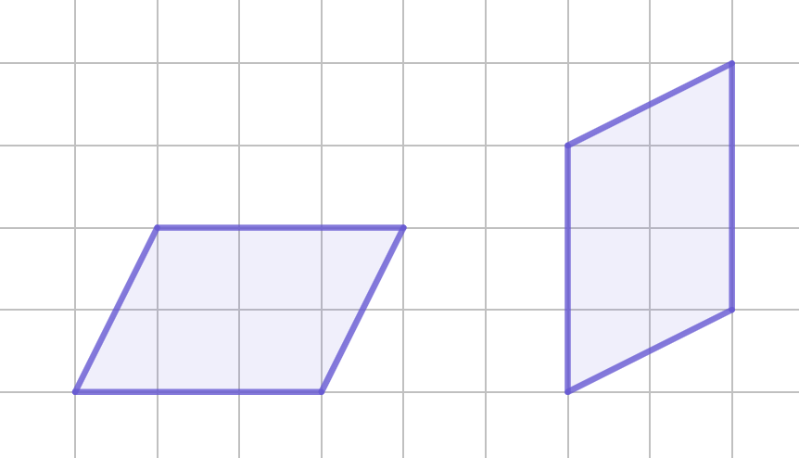
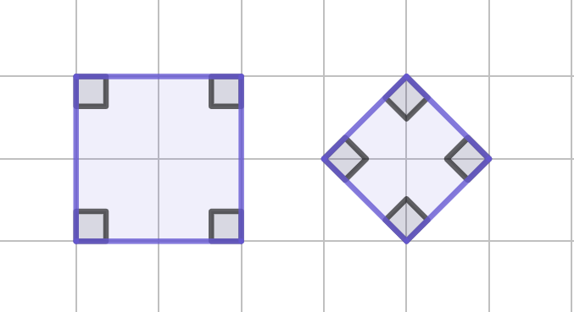
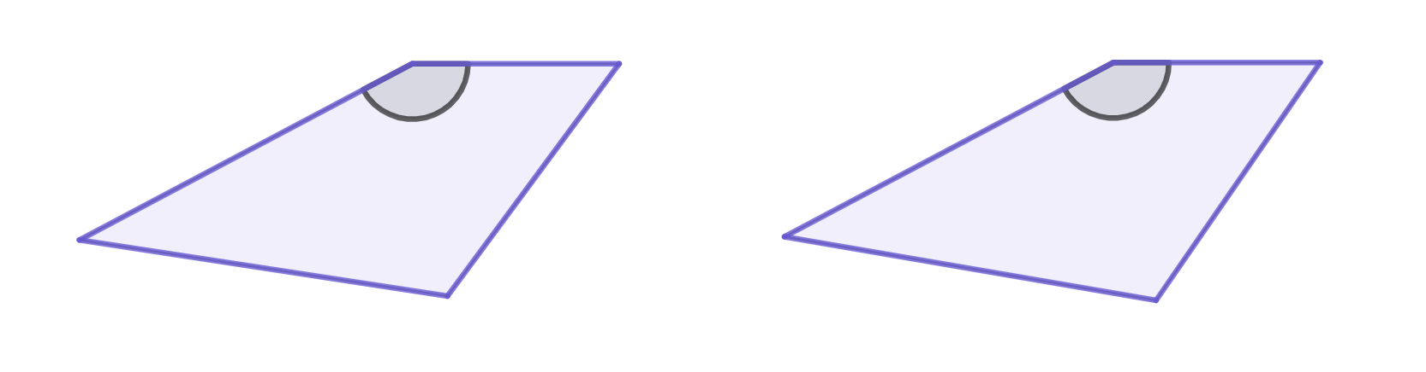
Congruency
Are the two shapes congruent or not? If not, why not?
b)
a)
c)
3 cm
3 cm
5.5 cm
5.4 cm
152°
152°
4.2 cm
4.2 cm
5.4 cm
5.5 cm

Slide 16
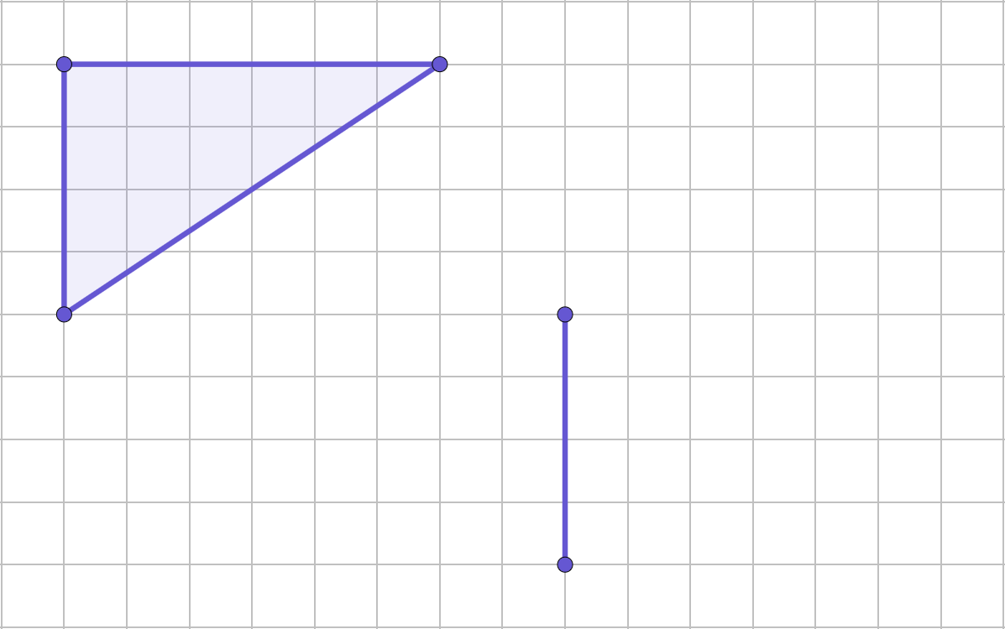
Congruency
Mark where you could put the third vertex to make the two triangles congruent. One edge has been given.

Slide 17
Congruency
1) Which of these triangles are congruent?
C
A, B, E and F are congruent to each other.
A
B
D
E
F
G

Slide 18
Congruency
2) Are the two shapes congruent or not? If not, why not?
a)
b)
Congruent
Not congruent as the sizes are different.

Slide 19

Congruency
Are the two shapes congruent or not? If not, why not?
c)
3 cm
3 cm
5.5 cm
5.4 cm
152°
152°
4.2 cm
4.2 cm
5.4 cm
5.5 cm
These shapes are not congruent as the edges with the same length are in different places.

Slide 20
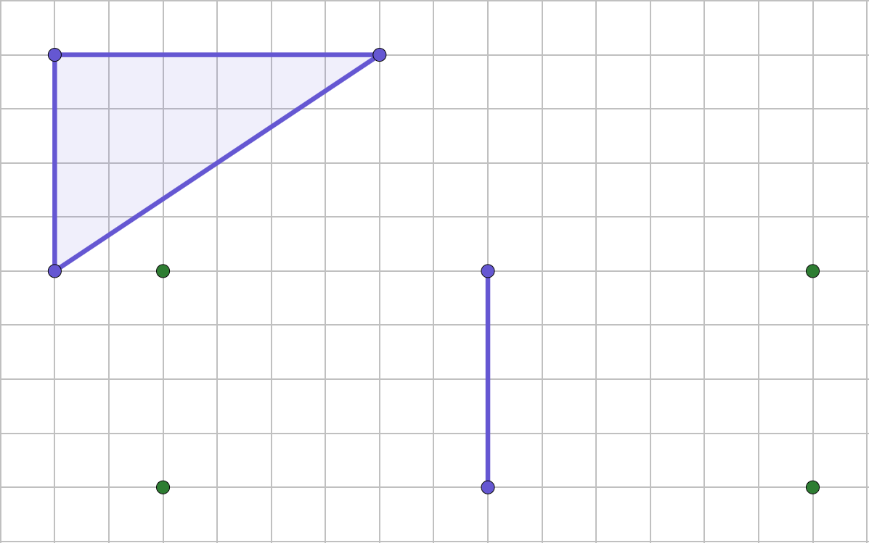
Congruency
Mark where you could put the third vertex to make the two triangles congruent. One edge has been given.
There are four places you could have chosen.

Slide 21
Checking understanding of basic transformations
Congruency
Describing changes

Slide 22
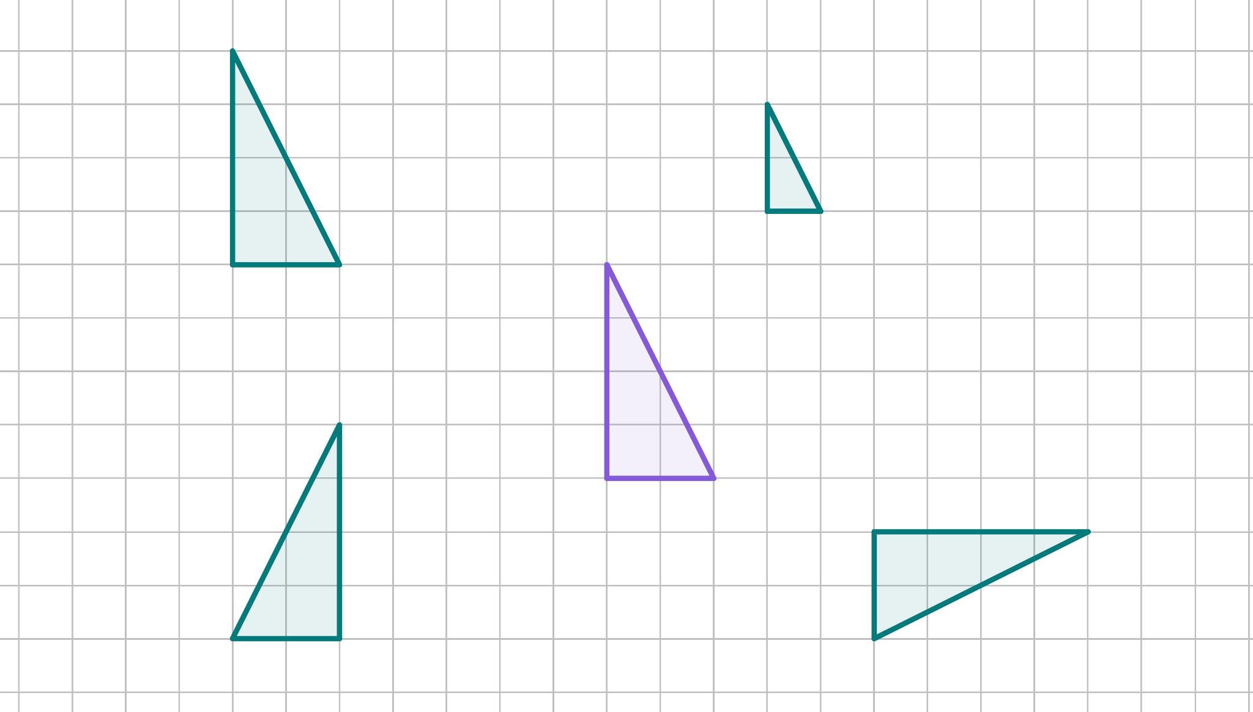
Describing changes
Triangle A has been transformed four different ways.
What does it mean to transform?
A

Slide 23
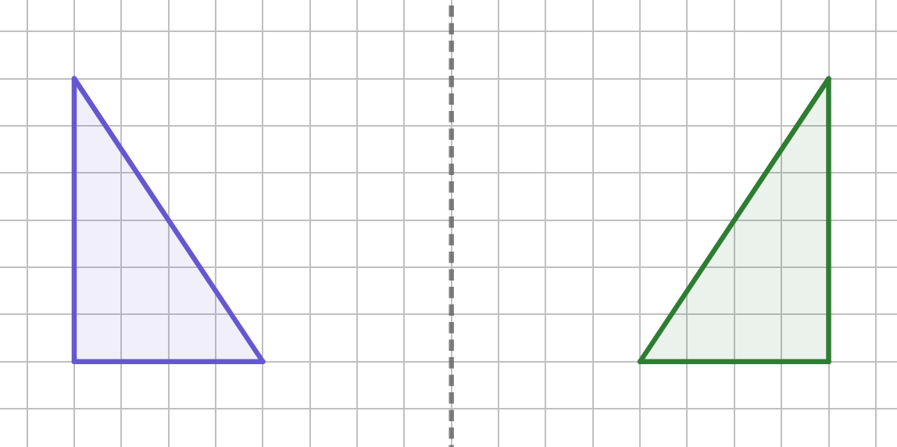
Describing changes
When transformations are applied to a figure, we must consider which is the object and which is the image.
When you look at yourself in the mirror, you are the object, your reflection is the image of yourself.
object
image

Slide 24
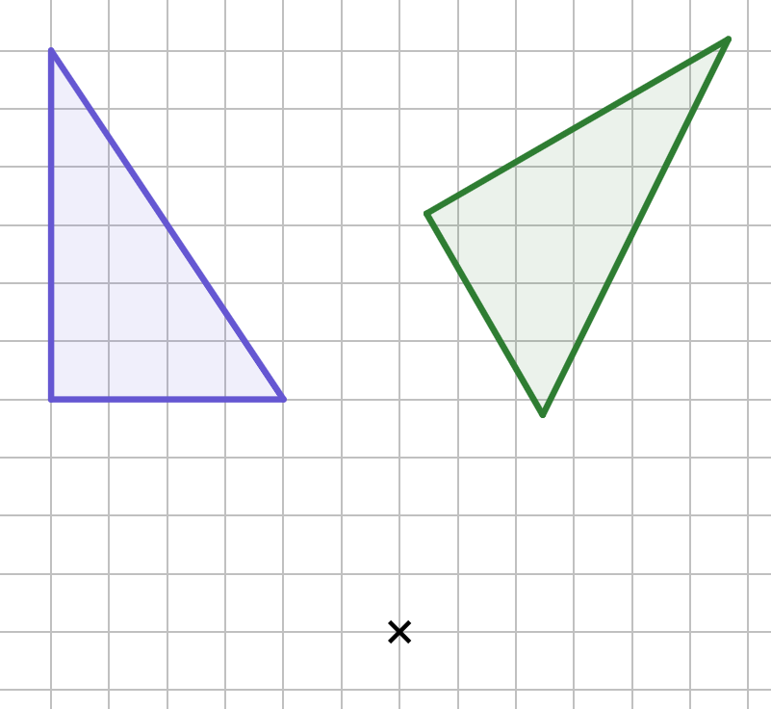
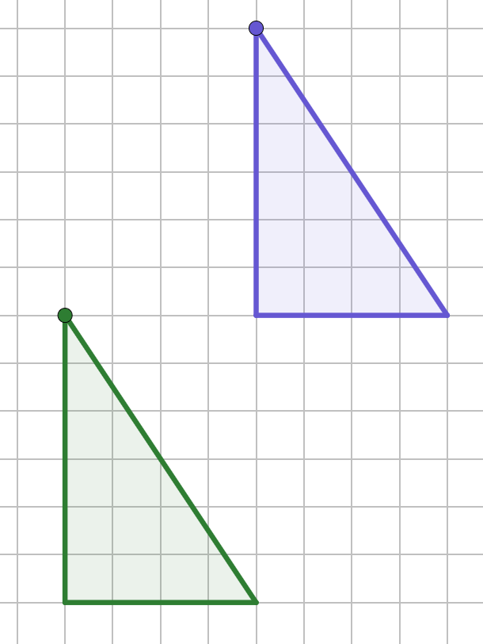
Describing changes
Here are some more examples of an object and image.
object
image
A
object
image of point A
A′
image

Slide 25
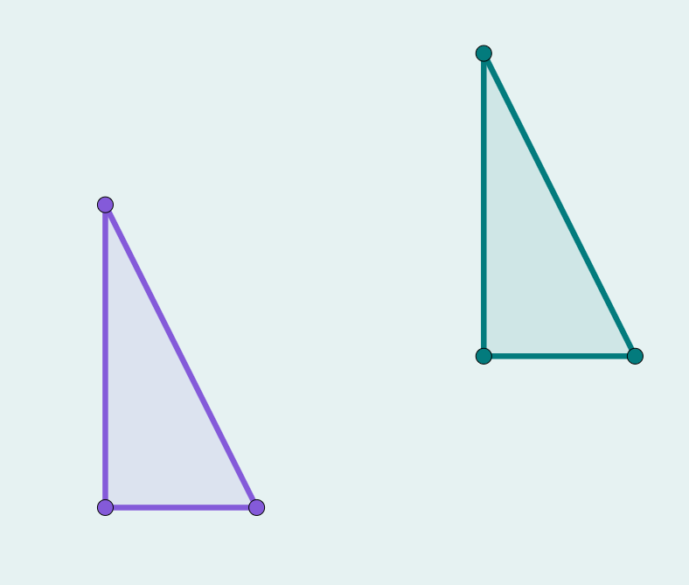
Describing changes
Complete the missing word and label.
A′
A
image
object
.
B′
C′
B
C

Slide 26

Describing changes
When an object has been transformed the result is the image.
We can describe the transformation based on how the object has changed.
A
The object has moved to the left and down.
A′
Andeep

Slide 27

Describing changes
object
image
The lengths and angles are the same. The position and orientation have changed and the image is mirrored.
It has been flipped.
When properties have stayed the same, we say they are invariant.
Lucas

Slide 28
Describing changes
A
Has the orientation changed?
No
object
Have the angles changed?
No
A′
Have the lengths changed?
No
image
Has the position changed?
Yes

Slide 29

Describing changes
A
The only change is the position. All the other properties are invariant.
The object has moved to become the image.
object
A′
image
Jun

Slide 30
Describing changes
Complete the table for each property.
object
image
Property | Changed - yes/no?
Orientation | Yes
Lengths
Position | Yes
Angles | No
Mirrored | No
No

Slide 31


Describing changes
Sam has described the image compared to its object.
The lengths and position have changed but all other properties are invariant.

Slide 32


Describing changes
Izzy has described the image compared to its object.
The image is congruent to the object. Its position and orientation has changed. It isn’t mirrored.

Slide 33

Describing changes
The description states how the image has changed.
It states how the object has changed.
It states the differences between the image and object.

Slide 34
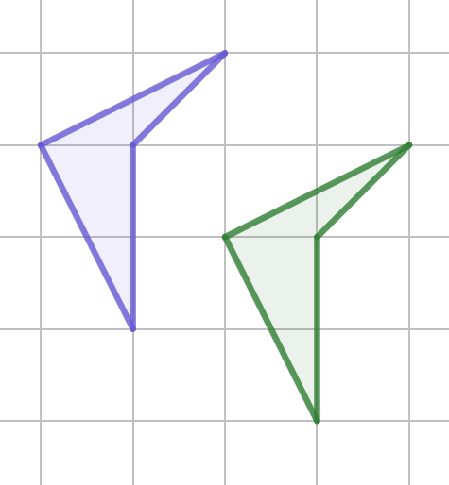
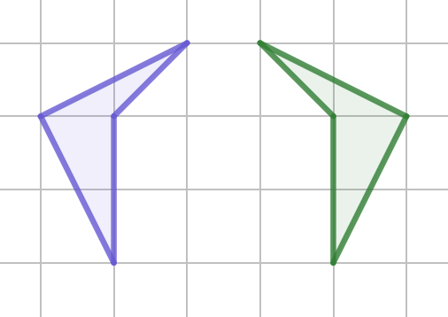
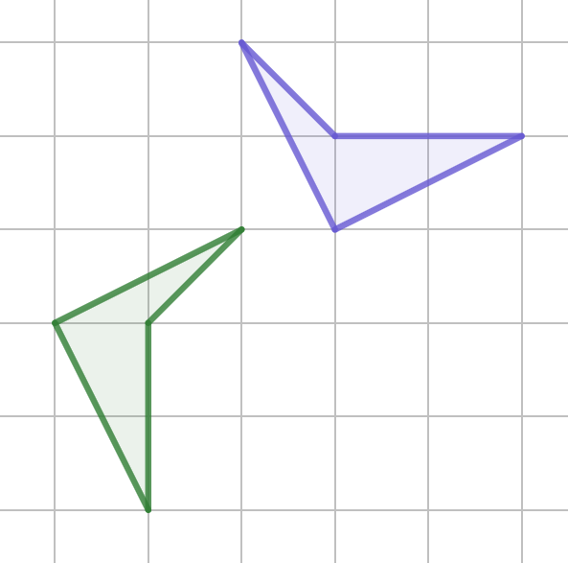
Describing changes
1) Match the descriptions to the correct figure.
The image is congruent but mirrored.
The image is congruent and has the same orientation as the object.
The image is congruent but the orientation has changed from the object.

Slide 35
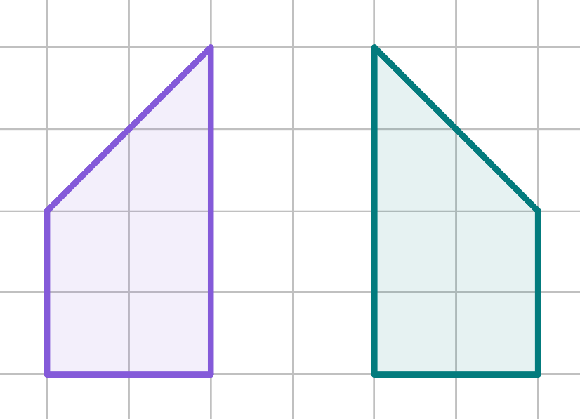
Describing changes
Complete the table regarding the properties of the image compared to the object and then use it to write a description.
Property | Changed - yes/no?
Orientation
Lengths
Position
Angles
Mirrored

Slide 36
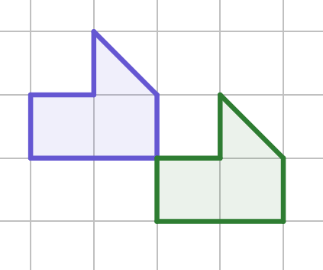
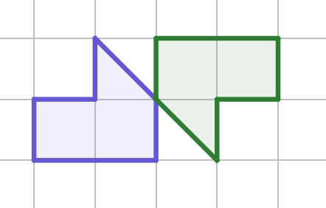
Describing changes
Write a description for the two transformations.
b)
a)

Slide 37
Describing changes
1) Match the descriptions to the correct figure.
The image is congruent but mirrored.
The image is congruent and has the same orientation as the object.
The image is congruent but the orientation has changed from the object.

Slide 38
Describing changes
Complete the table regarding the properties of the image compared to the object and then use it to write a description.
Property | Changed - yes/no?
Orientation | yes
Lengths | no
Position | yes
Angles | no
Mirrored | yes
The lengths and angles are invariant. Its orientation and position has changed. It is a mirror image of the object.

Slide 39
Describing changes
3) Write a description for the two transformations.
a)
b)
Your descriptions may include:
The object and image are congruent but in a different position.
The image has a different orientation to the object.

Slide 40
Checking understanding of basic transformations
A congruent shape has not changed size, but may be translated, rotated or reflected.
A description states how an object been changed.
When a transformation has taken place, some of the properties change and some are invariant.

Slide 41

© Oak National Academy 2023.
Produced in partnership with Mathematics in Education and Industry .
Licensed on the Open Government Licence v3.0, except where otherwise stated. See Oak terms and conditions.

